Slide 1
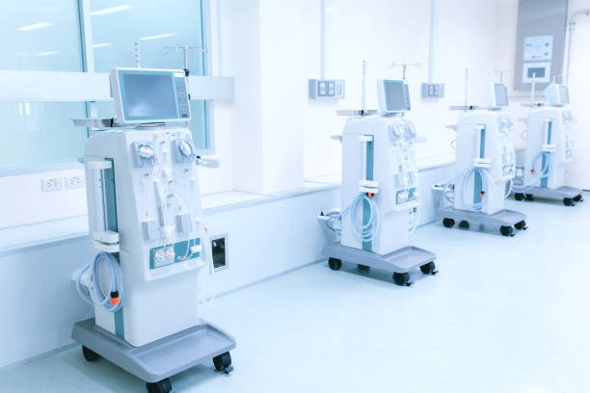
Health Care Analysis
Report

Slide 2
Team Members
Swati Jadon
Afrin Fathima
Aswathi

Slide 3
CONTENTS
INTRODUCTION
KPI’S
WORK DONE
FINDINGS AND INSIGHTS
SOLUTIONS

Slide 4



INTRODUCTION
Through this presentation, we aim to provide you with a deeper understanding of dialysis and its impact, as well as highlight potential areas for improvement and further research in this field.
Understanding Dialysis and Its Importance:
Dialysis is a life-saving treatment for patients with kidney failure.
According to the national kidney foundation over 500,000 people in the United States receiving dialysis treatments.
This highlights the importance of understanding dialysis and its impact on individuals' lives.
Overview of the Dialysis Dataset
The dialysis dataset used in this presentation was sourced from multiple healthcare facilities and includes information on patients receiving dialysis treatments.
The dataset include medical history and treatment details for the patient.

Slide 5
KPI’S
1.
5.
Number of Patients Across Various Summary
No of Category Text – As Expected
2.
6.
Profit vs Non-Profit
No of Score Applied - Improvement
3.
Top 3 Chain Organization in terms of no. of dialysis stations
7.
Top 3 Facilities in terms of Total Performance Score
4.
8.
Dialysis Station Stats
Average Payment Reduction Rate

Slide 6

z
1
2
3
4
EXCEL DASHBOARD & MySQL
1
2
3
4
TABLEAU DASHBOARD
Work Done
1
2
3
4
POWER BI DASHBOARD
4
FINAL PRESENTATION

Slide 7
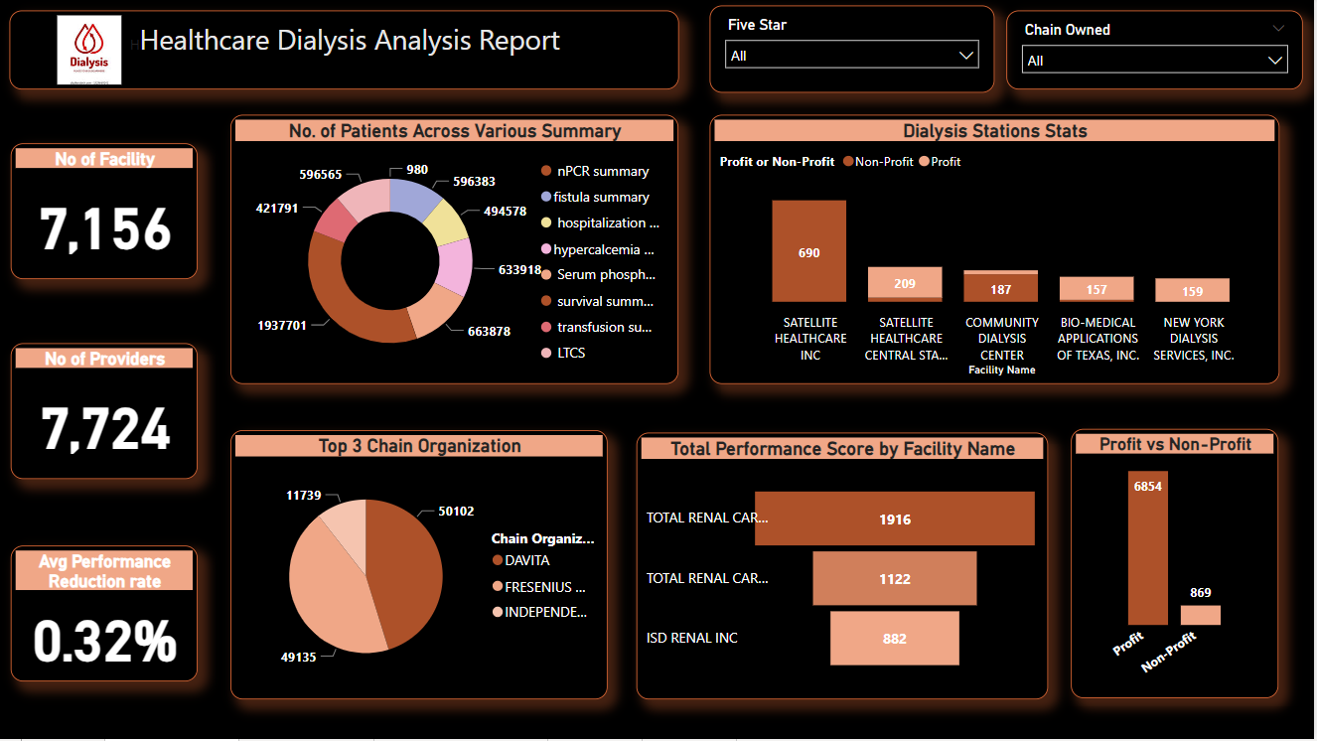
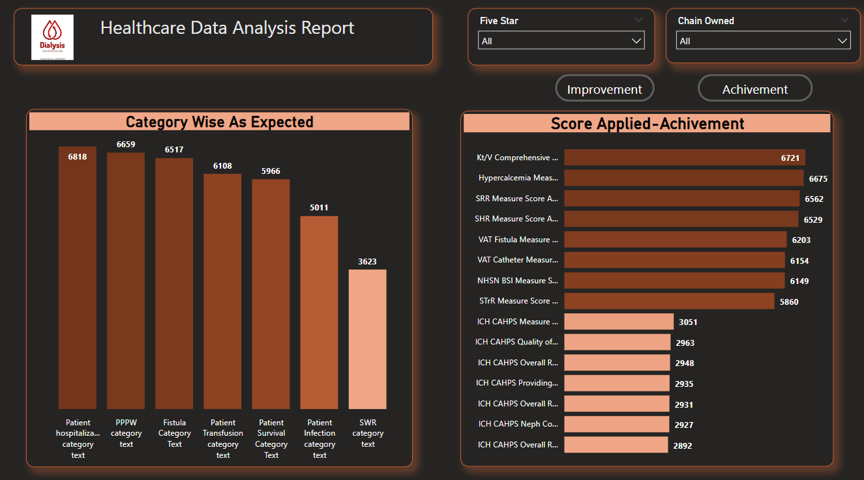
POWER BI DASHBOARD

Slide 8
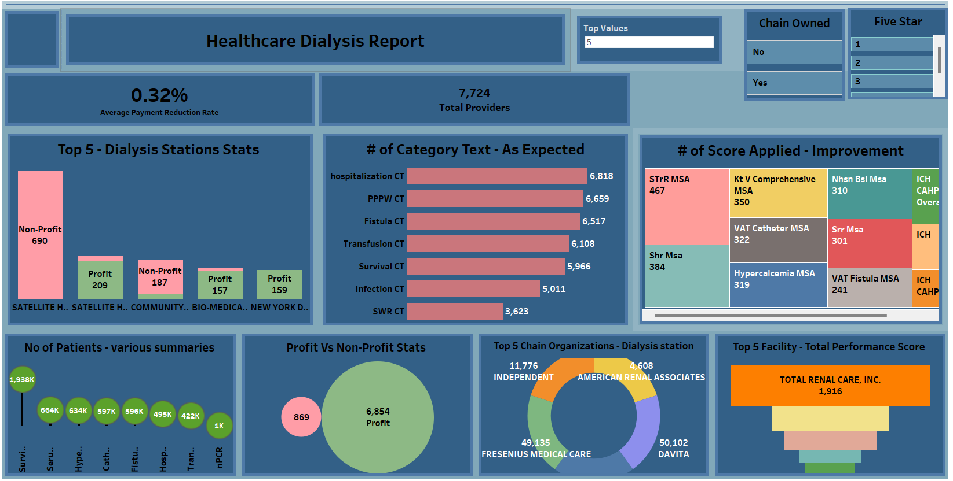
TABLEAU DASHBOARD

Slide 9
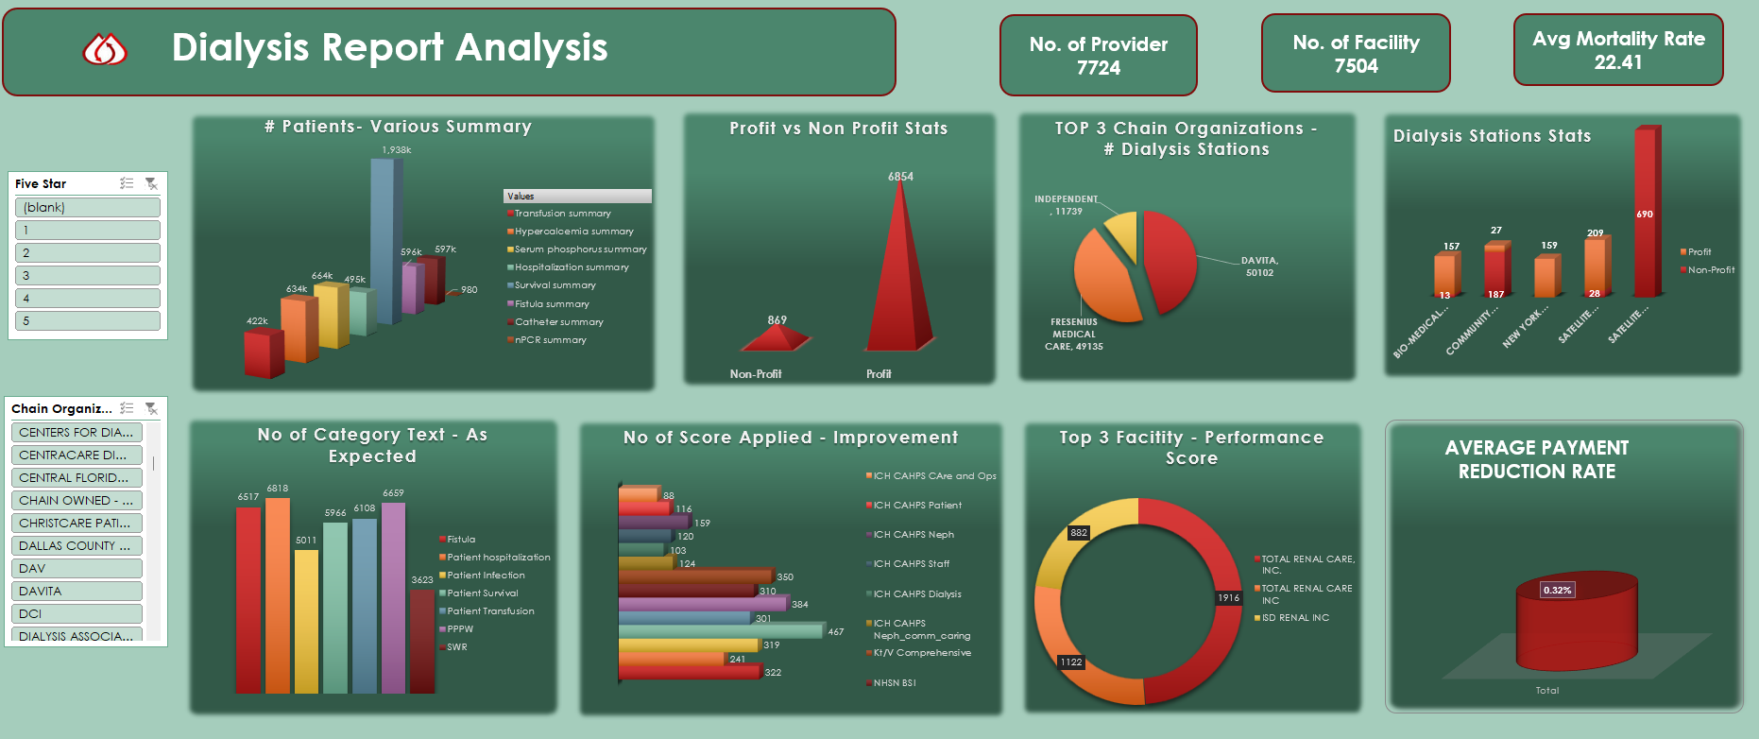
EXCEL DASHBOARD

Slide 10
Findings & Insights

Slide 11
KPI-1
A higher number of patients in survival summary indicates better patient outcomes.
Hypercalcemia and high serum phosphorus levels are common complications can lead to bone disease, cardiovascular disease, and even death, by controlling serum phosphorus levels can improve survival rates and reduce the risk of complications.
Fistulas and catheters are two common methods used for dialysis treatment. While fistulas are generally considered the preferred option, they can be difficult to create and maintain.
Catheters are easier to use but have a higher risk of infection.
Hospitalization can be stressful for patients and their families, as well as costly for healthcare systems.
Normalized protein catabolic rate (nPCR) is a measure of protein intake and metabolism among dialysis patients
Healthcare providers can work with patients to develop personalized nutrition plans and provide education on the importance of proper nutrition.
Solution:
Improving patient outcomes requires a collaborative effort between healthcare professionals, patients, and their families.

Slide 12
KPI - 2
This one is important because it can reveal valuable information about the healthcare industry.
Based on the data, higher number of profit facilities when compared to non-profit facilities.
Insights:
Profit dialysis centres tend to have higher mortality rates than non-profit centres.
This may be due to differences in staffing levels, quality of care, or other factors.
Challenges and Opportunities:
How to improve the quality of care provided by for-profit centres, which tend to have worse outcomes than non-profit centres.
How to address the financial incentives that may drive for-profit centres to prioritize profits over patient care.
Solution:
Increase staffing levels and provide more training for healthcare providers.
Implement quality improvement programs that focus on patient outcomes rather than profits.

Slide 13
KPI - 3
The number of dialysis stations available in a chain organization can have a significant impact on patient care and outcomes.
The top 3 chain organizations in terms of the number of dialysis stations are Fresenius Medical Care, DaVita Inc., and U.S. Renal Care.
DaVita Medical Care has the largest number of dialysis stations, with over 50000 locations worldwide. Fresenius Medical Care comes in second, with approximately 49135, while U.S. Renal Care has just over 11000 station.
Chain Organization | Total Dialysis Stations | Total Dialysis With 5 as Five star
DAVITA | 50102 | 14655
FRESENIUS MEDICAL CARE | 49135 | 12905
INDEPENDENT | 11739 | 2146

Slide 14
KPI - 4
The statistics related to dialysis stations are both informative and sobering. In the United States alone, there are over 7,000 dialysis facilities serving more than 500,000 patients with kidney disease. The success rates of treatment vary depending on a number of factors, including the patient's age, overall health, and the underlying cause of their kidney disease.
Insights:
By identifying these patterns and disparities, healthcare professionals and policymakers can work to address the root causes of these issues and implement targeted interventions to improve patient outcomes and increase access to care for all.

Slide 15
KPI - 5
The Importance of Categories:
Patient Hospitalization is Showing the Highest As Expected Count with 1984
SWR is Showing the Lowest As Expected Count with 865.
Analyzing the number of categories in the dialysis dataset can provide valuable insights into patient outcomes and treatment effectiveness
Furthermore, having a clear understanding of the categories present in the dataset can help identify gaps in the data and inform future research priorities. By knowing what categories are missing or underrepresented in the data, researchers can focus on collecting more complete and representative data to improve the accuracy and usefulness of dialysis research.

Slide 16
KPI - 6
The Percentage of Improvement Across the total Score Applied is 3.05 %
The Percentage of Achievement Across the total Score Applied is 64.24%
Standardized Transfusion Ratio (STrR) is Showing the Highest Improvement rate with 467
ICH CAHPS Care and ops is showing the lowest improvement rate with 88
Through our research, we have found that applying more scores to the dialysis dataset can help identify areas for improvement in patient care, reduce costs, and ultimately save lives. We believe that this is an important topic that deserves attention and action.

Slide 17
KPI - 7
Total performance score is a measure of a dialysis facility's performance based on various quality measures like clinical outcomes, patient experience, and safety standards.
The score is calculated using data from the Centres for Medicare & Medicaid Services (CMS) and is reported on a scale of 0 to 100.
Top 3 Facilities:
These facilities have all demonstrated strong performance in a variety of areas, including safety, efficiency, and quality of care.
Total Renal Care, INC has achieved a total performance score of 61.81, which is the highest in the dataset. They have excelled in clinical outcomes, with low rates of hospitalization and mortality.
TOTAL RENAL CARE INC and ISD RENAL INC have also performed well, with scores of 59.05 and 58.80 respectively. They have both shown strong patient experience metrics and have implemented effective safety standards
Solutions for Improving Performance
Reducing infection rates or improving patient satisfaction.
Invest in staff training and development. By providing ongoing education and support
Facilities can collaborate with other organizations and share best practices to learn from one another and drive continuous improvement

Slide 18
KPI - 8
This metric is important because it helps us understand the financial impact of dialysis treatments on patients and healthcare providers.
Insights:
Patients who receive longer or more frequent treatments tend to have higher payment reduction rates.
Challenges:
One major obstacle is the high cost of dialysis treatments, which can make it difficult for healthcare providers to provide high-quality care while also keeping costs low.
there are often disparities in access to care and resources among different patient populations, which can further complicate efforts to reduce payment reduction rates.
Solution::
By leveraging technology and data analytics, we can also identify areas where improvements can be made and develop targeted interventions to reduce payment reduction rates.
These include improving patient education and self-care, increasing access to preventative care and early intervention, and implementing more efficient and cost-effective treatment protocols.

Slide 19

THANK YOU

